Slide 1
CPT-S 415
Big Data
Yinghui Wu
EME B45

Slide 2
CPT-S 415
Big Data
Beyond Relational Data
noSQL databases
Column store
Document DBs
  MongoDB
Graph databases
  Neo4j
Notes:
Object.

Slide 3
Column store

Slide 4
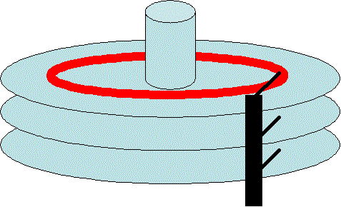
Row Store and Column Store
Most of the queries does not process all the attributes of a particular relation.
For example the query
  Select c.name and c.address
  From CUSTOMER as c
  Where c.region=Pullman;
Only process three attributes of the relation CUSTOMER. But the customer relation can have more than three attributes.
more I/O efficient for read-only queries as they read, only those attributes which are accessed by a query.

Slide 5
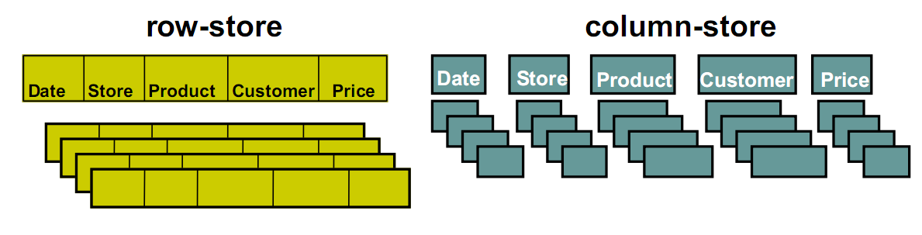
Row Store and Column Store
In row store data are stored in the disk tuple by tuple.
Where in column store data are stored in the disk column by column

Slide 6
Row-stores
In a row-store, a.k.a. row-wise storage or n-ary storage model, NSM:
all rows of a table are stored sequentially on a database page.
a₁ b₁ c₁ d₁
a1 c
b1
c1 a
a4 c
b4
c4
1
d
1
2
4
d
4
a₂ b₂ c₂ d₂
b2 d
c2
d2 b
a₃ b₃ c₃ d₃
2
a
3
3
c3
d3
a₄ b₄ c₄ d₄
page 0
page 1

Slide 7
Column-stores
a.k.a. column-wise storage or decomposition storage model, DSM:
a₁ b₁ c₁ d₁ a₂ b₂ c₂ d₂ a₃ b₃ c₃ d₃ a₄ b₄ c₄ d₄
a1 a
a2
a3
b1 b
b2
b3
3
a
4
3
b
4
· · ·
page 0
page 1

Slide 8
The effect on query processing
Consider, e.g., a selection query:
SELECT COUNT(*)
FROM lineitem
WHERE l_shipdate = "2017-10-19"
This query typically involves a full table scan.

Slide 9
A full table scan in a row-store
In a row-store, all rows of a table are stored sequentially on a database page.
l_shipdate
tuple

Slide 10
A full table scan in a row-store
In a row-store, all rows of a table are stored sequentially on a database page.
l_shipdate
tuple
cache block boundaries
With every access to a l_shipdate field, load a large amount of irrelevant information into the cache.

Slide 11
A ”full table scan” on a column-store
In a column-store, all values of one column are stored sequentially on a database page.
l_shipdate(s)

Slide 12
A ”full table scan” on a column-store
In a column-store, all values of one column are stored sequentially on a database page.
l_shipdate(s)
cache block boundaries
All data loaded into caches by a “l_shipdate scan” is now actually relevant for the query.

Slide 13
Column-store advantages
Less data has to be fetched from memory.
Amortize cost for fetch over more tuples.
The same arguments hold also for in-memory based systems (we will see soon).
Additional benefit: Data compression might work better.

Slide 14
Why Column Stores?
Can be significantly faster than row stores for some applications
  Fetch only required columns for a query
  Better cache effects
  Better compression (similar attribute values within a column)
But can be slower for other applications
  OLTP with many row inserts, ..
Long war between the column store and row store camps :-)

Slide 15
Row Store and Column Store
Column stores are suitable for read-mostly, read-intensive, large data repositories
Row Store | Column Store
(+) Easy to add/modify a record | (+) Only need to read in relevant data
(-) Might read in unnecessary data | (-) Tuple writes require multiple accesses

Slide 16
Column store noSQL system

Slide 17
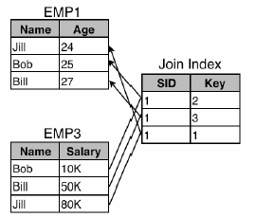
Column Stores - Data Model
Standard relational logical data model
  EMP(name, age, salary, dept)
  DEPT(dname, floor)
Table – collection of projections
Projection – set of columns
Horizontally partitioned into segments with segment identifier

Slide 18
Column Stores - Data Model
To answer queries, projections are joined using Storage keys and join indexes
Storage Keys:
  Within a segment, every data value of every column is associated with a unique Skey
  Values from different columns with matching Skey belong to the same logical row

Slide 19
Column Stores – Data Model
Join Indexes
  T1 and T2 are projections on T
  M segments in T1 and N segments in T2
  Join Index from T1 to T2 is a table of the form:
    (s: Segment ID in T2, k: Storage key in Segment s)
    Each row in join index matches corresponding row in T1
  Join indexes are built such that T could be efficiently reconstructed from T1 and T2
Construct EMP(name, age, salary) from EMP1 and EMP3 using join index on EMP3

Slide 20
Compression
Trades I/O for CPU
  Increased column-store opportunities:
  Higher data value locality in column stores
  Data compression techniques such as run length encoding far more useful
Schemes
  Null Suppression
  Dictionary encoding
  Run Length encoding
  Bit-Vector encoding
  Heavyweight schemes

Slide 21
Query Execution - Operators
Select: Same as relational algebra, but produces a bit string
Project: Same as relational algebra
Join: Joins projections according to predicates
Aggregation: SQL like aggregates
Sort: Sort all columns of a projection
Decompress: Converts compressed column to uncompressed representation
Mask(Bitstring B, Projection Cs) => emit only those values whose corresponding bits are 1
Concat: Combines one or more projections sorted in the same order into a single projection
Permute: Permutes a projection according to the ordering defined by a join index
Bitstring operators: Band – Bitwise AND, Bor – Bitwise OR, Bnot – complement

Slide 22
Row Store Vs Column Store
One can obtain the performance beneﬁts of a column-store using a row-store by making some changes to the physical structure of the row store.
  Vertically partitioning
  Using index-only plans
  Using materialized views

Slide 23
Vertical Partitioning
Process:
  Full Vertical partitioning of each relation
    Each column =1 Physical table
      by adding integer position column to every table
  Join on Position for multi column fetch
Problems:
  “Position” - Space and disk bandwidth
  Header for every tuple – further space wastage
    e.g. 24 byte overhead in PostgreSQL

Slide 24
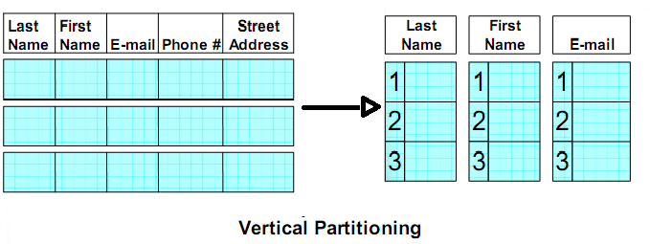
Vertical Partitioning: Example

Slide 25
Index-only plans
Process:
  Add B+Tree index for every Table.column
  Plans never access the actual tuples on disk
  Headers are not stored, so per tuple overhead is less
Problem:
  Separate indices may require full index scan, which is slower
  Eg: SELECT AVG(salary)
  FROM emp
  WHERE age > 40
  Composite index with (age, salary) key helps.

Slide 26
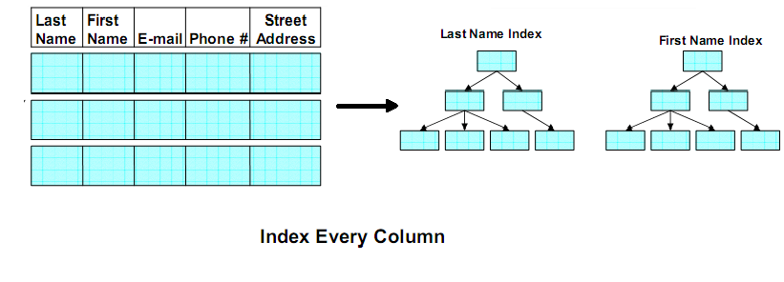
Index-only plans: Example

Slide 27
Materialized Views
Process:
  Create ‘optimal' set of MVs for given query workload
  Objective:
    Provide just the required data
    Avoid overheads
    Performs better
Expected to perform better than other two approach
Problems:
  Practical only in limited situation
  Require knowledge of query workloads in advance

Slide 28
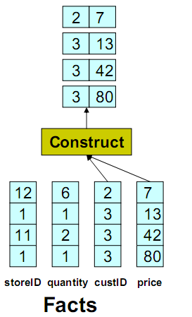
Materialized Views: Example
Select F.custID
from Facts as F
where F.price>20

Slide 29
Optimizing Column oriented Execution
Different optimization for column oriented database
  Compression
  Late Materialization
  Block Iteration

Slide 30
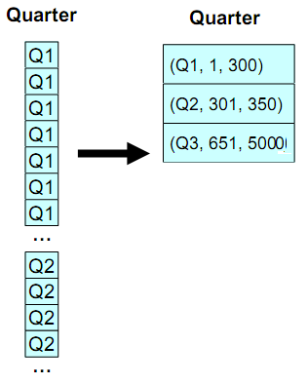
Compression
column can be super-compressible
eg. Run length encoding

Slide 31
Compression
Low information entropy (high data value locality) leads to High compression ratio
Advantage
  Disk Space is saved
  Less I/O
  CPU cost decrease if we can perform operation without decompressing
Light weight compression schemes do better

Slide 32
Late Materialization
Most query results entity-at-a-time not column-at-a-time
Idea: Delay Tuple Construction
Might avoid constructing it altogether
Intermediate position lists might need to be constructed
Eg: SELECT R.a FROM R WHERE R.c = 5 AND R.b = 10
  Output of each predicate is a bit string
  Perform Bitwise AND
  Use final position list to extract R.a
Advantages: Unnecessary construction of tuple is avoided
  Direct operation on compressed data
  Cache performance is improved

Slide 33
Block Iteration
Operators operate on blocks of tuples at once
Iterate over blocks rather than tuples
If column is fixed width, it can be operated as an array
Minimizes per-tuple overhead
Exploits potential for parallelism
Can be applied even in Row stores – IBM DB2 implements it

Slide 34
Document DB

Slide 35
Document DB
Documents are the main concept.
A Document-oriented database stores and retrieves documents (XML, JSON, BSON and so on).
Documents are:
  Self-describing
  Hierarchical tree data structures (maps, collection and scalar values)

Slide 36
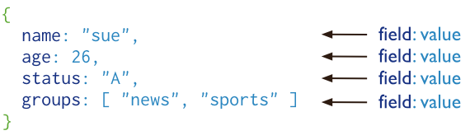
What is a Document DB?
Document databases store documents in the value part of the key-value store
Documents may have different attributes
Different from relational databases where columns stores the same type of values or null

Slide 37
MongoDB
MongoDB Features
  Document-Oriented storage
  Index Support
  Replication & Availability
  Auto-Sharding
  Ad-hoc Querying
  Fast In-Place Updates
  Map/Reduce functionality

Slide 38

MongoDB: CAP approach
Focus on Consistency and Partition tolerance
C
Consistency
  all replicas contain the same version of the data
Availability
  system remains operational on failing nodes
Partition tolarence
  multiple entry points
  system remains operational on system split
A
P
CAP Theorem:
satisfying all three at the same time is impossible
20

Slide 39
Document DB: Data model

Slide 40
MongoDB: Hierarchical Objects
A MongoDB instance may have zero or more ‘databases’
A database may have zero or more ‘collections’.
A collection may have zero or more ‘documents’.
A document may have one or more ‘fields’.
MongoDB ‘Indexes’ function much like their RDBMS counterparts.
0 or more Databases
0 or more Collections
0 or more Documents
0 or more Fields

Slide 41
The _id Field
By default, each document contains an _id field. This field has a number of special characteristics:
  Value serves as primary key for collection.
  Value is unique, immutable, and may be any non-array type.
  Default data type is ObjectId, which is “small, likely unique, fast to generate, and ordered.”
{ "_id" : "37010"
"city" : "ADAMS",
"pop" : 2660,
"state" : "TN",}
http://docs.mongodb.org/manual/reference/bson-types/

Slide 42
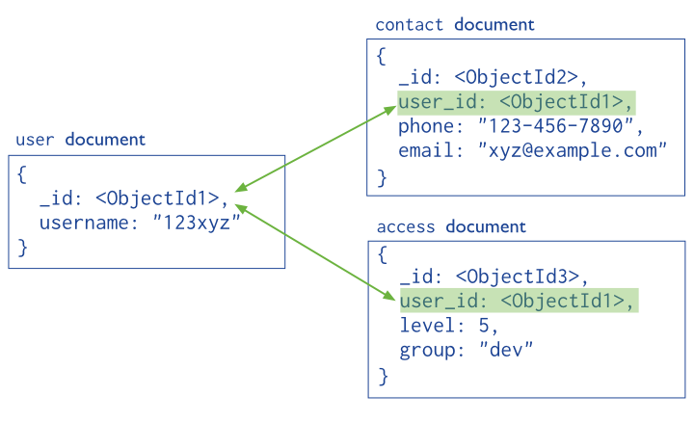
Documents: Structure References

Slide 43
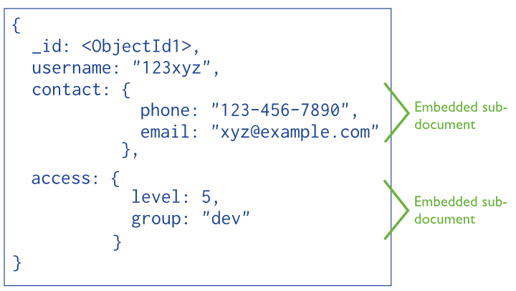
Documents: Structure Embedded

Slide 44
RDB Concepts to Document DB
RDBMS
MongoDB
Database
Database
Table, View
Collection
Row
Document (BSON)
Column
Field
Index
Index
Join
Embedded Document
Foreign Key
Reference
Partition
Shard

Slide 45
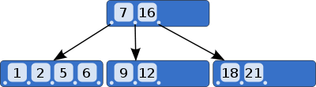
Documents: Indexing
Indexes allows efficient queries on MongoDB.
They are used to limit the number of documents to inspect (Otherwise, scan every document in a collection)
By default MongoDB create indexes only on the _id field
Indexes are created using B-tree and stores data of fields ordered by values.
In addition, returns sorted results by using the index.

Slide 46
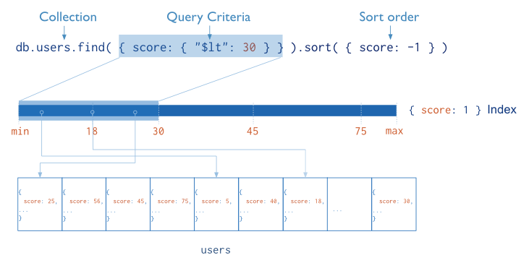
Documents: Indexing
Notes:
Fundamentally, indexes in MongoDB are similar to indexes in other database systems. MongoDB defines indexes at the collection level and supports indexes on any field or sub-field of the documents in a MongoDB collection.

Slide 47
Document DB: CRUD

Slide 48
CRUD
Create
  db.collection.insert( <document> )
  db.collection.save( <document> )
  db.collection.update( <query>, <update>, { upsert: true } )
Read
  db.collection.find( <query>, <projection> )
  db.collection.findOne( <query>, <projection> )
Update
  db.collection.update( <query>, <update>, <options> )
Delete
  db.collection.remove( <query>, <justOne> )
Notes:
Create
The field name _id is reserved for use as a primary key; its value must be unique in the collection, is immutable, and may be of any type other than an array.
The field names cannot start with the $ character.
The field names cannot contain the . character.
Create with save
If the <document> argument does not contain the _id field or contains an _id field with a value not in the collection, the save() method performs an insert of the document.
Otherwise, the save() method performs an update.
sds

Slide 49

CRUD example
> db.user.insert({
first: "John",
last : "Doe",
age: 39
})
> db.user.find ()
{
"_id" : ObjectId("51…"),
"first" : "John",
"last" : "Doe",
"age" : 39
}
> db.user.update(
{"_id" : ObjectId("51…")},
{ $set: {
age: 40,
salary: 7000}
}
)
> db.user.remove({
"first": /^J/
})

Slide 50
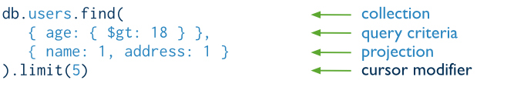
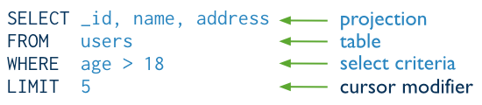
Query Interface
The same query in SQL

Slide 51
Document DB: Scaling

Slide 52
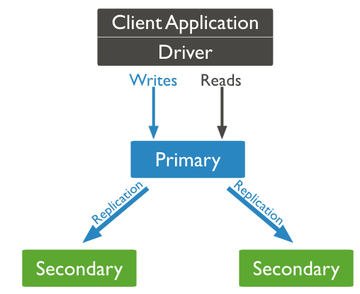
Replication of data
Ensures redundancy, backup, and automatic failover
  Recovery manager in the RDMS
Replication through groups of servers known as replica sets
  Primary set – set of servers that client tasks direct updates to
  Secondary set – set of servers used for duplication of data
  If the primary set fails the secondary sets ‘vote’ to elect the new primary set

Slide 53
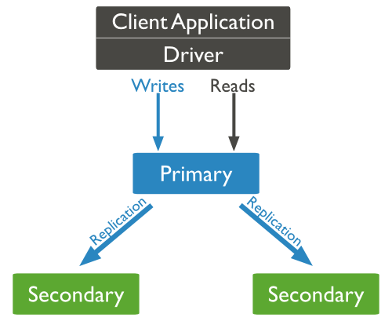
Scaling: Heavy Reads
Scaling is achieved by adding more read slaves
All the reads can be directed to the slaves.
When a node is added it will sync with the other nodes -- no need to stop the cluster.
rs.add(“mongo_address:27017”)

Slide 54
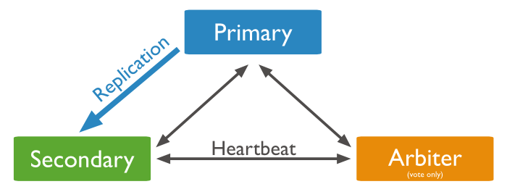
Data Replication

Slide 55
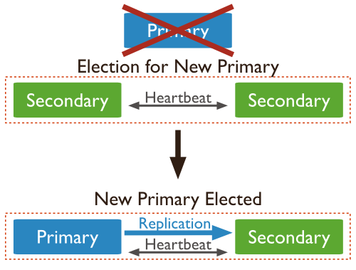
Automatic Failover

Slide 56
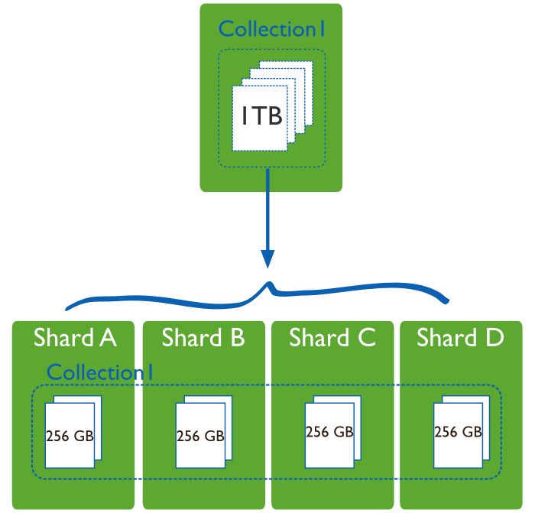
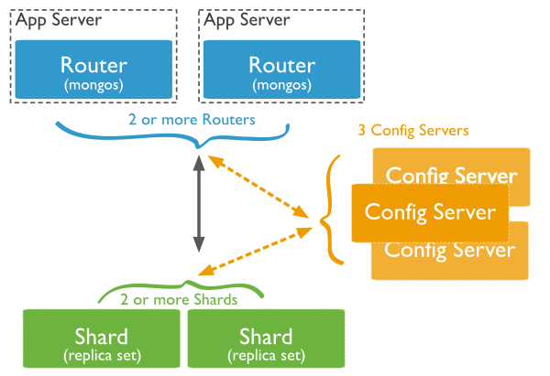
Sharding in MongoDB
Sharding, or horizontal scaling divides the data set and distributes the data over multiple servers.
Each shard is an independent database, and collectively, the shards make up a single logical database.
Query Routers: interface to client and direct queries
Config Server: store cluster’s metadata.

Slide 57
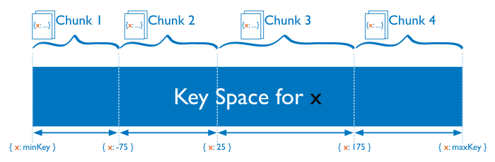
Range Based Sharding
divides the data set into ranges determined by the shard key values to provide range based partitioning.
supports more efficient range queries
However, result in an uneven distribution of data.

Slide 58
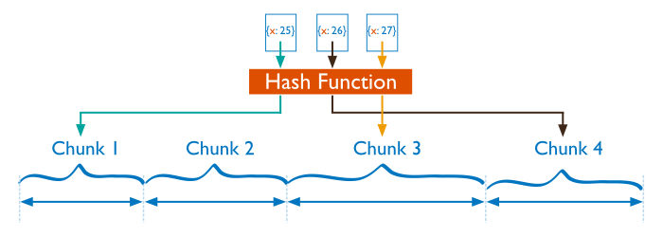
Hash Based Sharding
computes a hash of a field’s value, and then uses these hashes to create chunks
More likely to ensure even distribution of data at the expense of efficient range queries.

Slide 59
Document Store: Advantages
Documents are independent units
Application logic is easier to write. (JSON).
Schema Free:
  Unstructured data can be stored easily, since a document contains whatever keys and values the application logic requires.
  In addition, costly migrations are avoided since the database does not need to know its information schema in advance.

Slide 60
Suitable Use Cases
Event Logging: where we need to store different types of event (order_processed, customer_logged).
Content Management System: the schema-free approach is well suited
Web analytics or Real-Time Analytics: useful to update counters, page views and metrics in general.

Slide 61
When Not to Use
Complex Transactions: atomic cross-document operations
Queries against Varying Aggregate Structure: i.e., when the structure of the aggregates vary because of continuous data evolutions

Slide 62
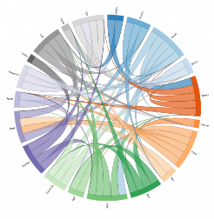

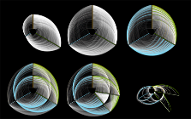



Graph databases

Slide 63
Motivations
The necessity to represent, store and manipulate complex data make RDBMS somewhat obsolete
Problem 1: Violations of the 1NF
  Multi-valued attributes
  Complex attributes
Problem 2 : Accommodate Changes
  acquiring data from autonomous dynamic sources or Web
  RDBMS require schema renormalization
Problem 3: Unified representation for:
  Data
  Knowledge (Schemas are a subset of this)
  Queries [results + def]
  Models (Concepts)

Slide 64
Existing Approaches
RDBMS –need schema renormalization
Approaches that try to fix the above mentioned problems:
  OO Databases [P1], [P2] - graphs [but procedural]
  XML Databases [P1] (somewhat [P3]) – trees
  OORDBMS [P1] – graphs with foreign keys
  RDF triple stores [P1, P2], somewhat [P3]
Others
  Datalog – more efficient fragment of Prolog
  Network Models - graphs
  Hierarchical Models – trees

Slide 65
What is a Graph Database?
A database with an explicit graph structure: Each node knows its adjacent nodes
As the number of nodes increases, the cost of a local step (or hop) remains the same; Plus an Index for lookups
Express Queries as Traversals. Fast deep traversal instead of slow SQL queries that span many table joins.
Very natural to express graph related problem with traversals (recommendation engine, find shortest path etc..)
Seamless integration with various existing programming languages.
  Two design principle: Declarativity & Change
Distinguish between “Database for graph as object”!

Slide 66
Database Representation
Sailors(sid:integer, sname:char(10), rating: integer, age:real)
Boats(bid:integer, bname:char(10), color:char(10))
Reserve(sid:integer, bid:integer, day:date)
  Sailors Reserves Boats
sid
sname
rating
age
sid
bid
day
bid
bname
color
22
dustin
7
45.0
22
101
10/10/96
101
Interlake
red
31
lubber
8
55.5
102
Clipper
green
58
103
11/12/96
103
Marine
red
58
rusty
10
35.0

Slide 67
Graph Representation
sid
22
name
dustin
IOF
ID1
rating
7
IOF
Sailors
age
45.0
TBL
sid
31
IOF
IOF
name
lubber
IOF
ID2
Boats
rating
8
Reserves
IOF
IOF
age
55.5
IOF
ID8
ID6
ID3
…
:
:
ID7
:
ID4
ID5
:
:

Slide 68
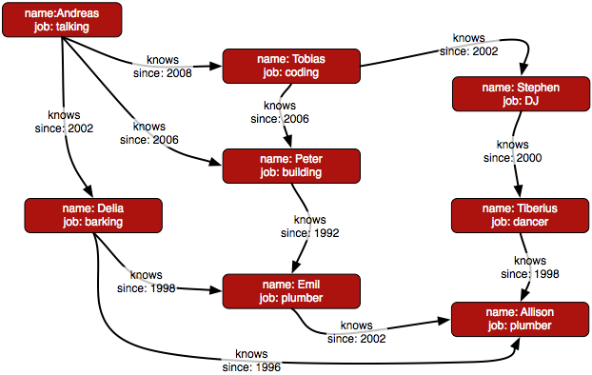
Property Graph

Slide 69
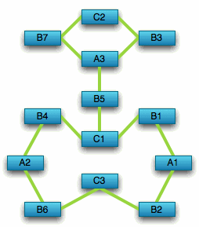
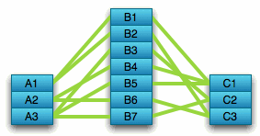
Compared to Relational Databases
Optimized for aggregation
Optimized for connections

Slide 70
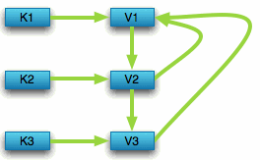

Compared to Key Value Stores
Optimized for
simple look-ups
Optimized for
traversing connected data

Slide 71
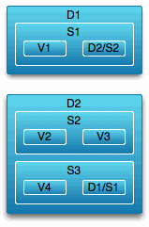
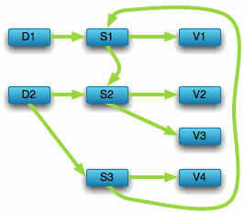
Compared to Document Stores
Optimized for
“trees” of data
Optimized for seeing the forest and the trees, the branches, and the trunks

Slide 72
Social Network “path exists” Performance
Experiment:
  ~1k persons
  Average 50 friends per person
  pathExists(a,b) limited to depth 4
 | # persons | query time
Relational database | 1000 | 2000ms
Neo4j | 1000 | 2ms
Neo4j | 1000000 | 2ms

Slide 73
Neo4j?
A Graph Database + Lucene Index
Property Graph
Full ACID (atomicity, consistency, isolation, durability) (?)
High Availability (with Enterprise Edition)
32 Billion Nodes, 32 Billion Relationships, 64 Billion Properties
Embedded Server
REST API
Notes:
Atomic = all or nothing, consistent = stay consistent from one tx to another, isolation = no tx will mess with another tx, durability = once tx committed, it stays

Slide 74
Good For
Highly connected data (social networks)
Recommendations (e-commerce)
Path Finding (how do I know you?)
A* (Least Cost path)
Data First Schema (bottom-up, but you still need to design)

Slide 75
Summary: noSQL systems

Slide 76
Summary
SQL Databases
  Predefined Schema
  Standard definition and interface language
  Tight consistency (ACID)
  Well defined semantics
NoSQL Database
  No predefined Schema
  Per-product definition and interface language
  Getting an answer quickly is more important than getting a correct answer (BASE)

Slide 77
Summary: noSQL Common Advantages
Cheap, easy to implement (open source)
Data are replicated to multiple nodes (therefore identical and fault-tolerant) and can be partitioned
  Down nodes easily replaced
  No single point of failure
Easy to distribute
Don't require a schema
Can scale up and down
Relax the data consistency requirement (CAP)
Notes:
-> As the data is written, the latest version is on at least one node. The data is then versioned/replicated to other nodes within the system.
-> Eventually, the same version is on all nodes.

Slide 78
Summary: What are we giving up?
joins
group by
order by
ACID transactions (none are strict ACID!)
SQL as a sometimes frustrating but still powerful query language
easy integration with other applications that support SQL
Notes:
-> No JDBC
-> Data integrity at the application layer

Slide 79
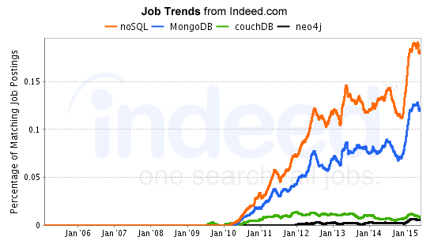
QSX (LN2)

Slide 80
